Slide 1
Sons of God:
In times of testing
2 Tim 3
14/10/18

Slide 2
Previous messages…
Casting out mindsets – renew & change
Our Father, My Father. Seek & know Him. Our God is great and He has a plan
The end times – Know and be ready. Times of testing - foundation (David)

Slide 3
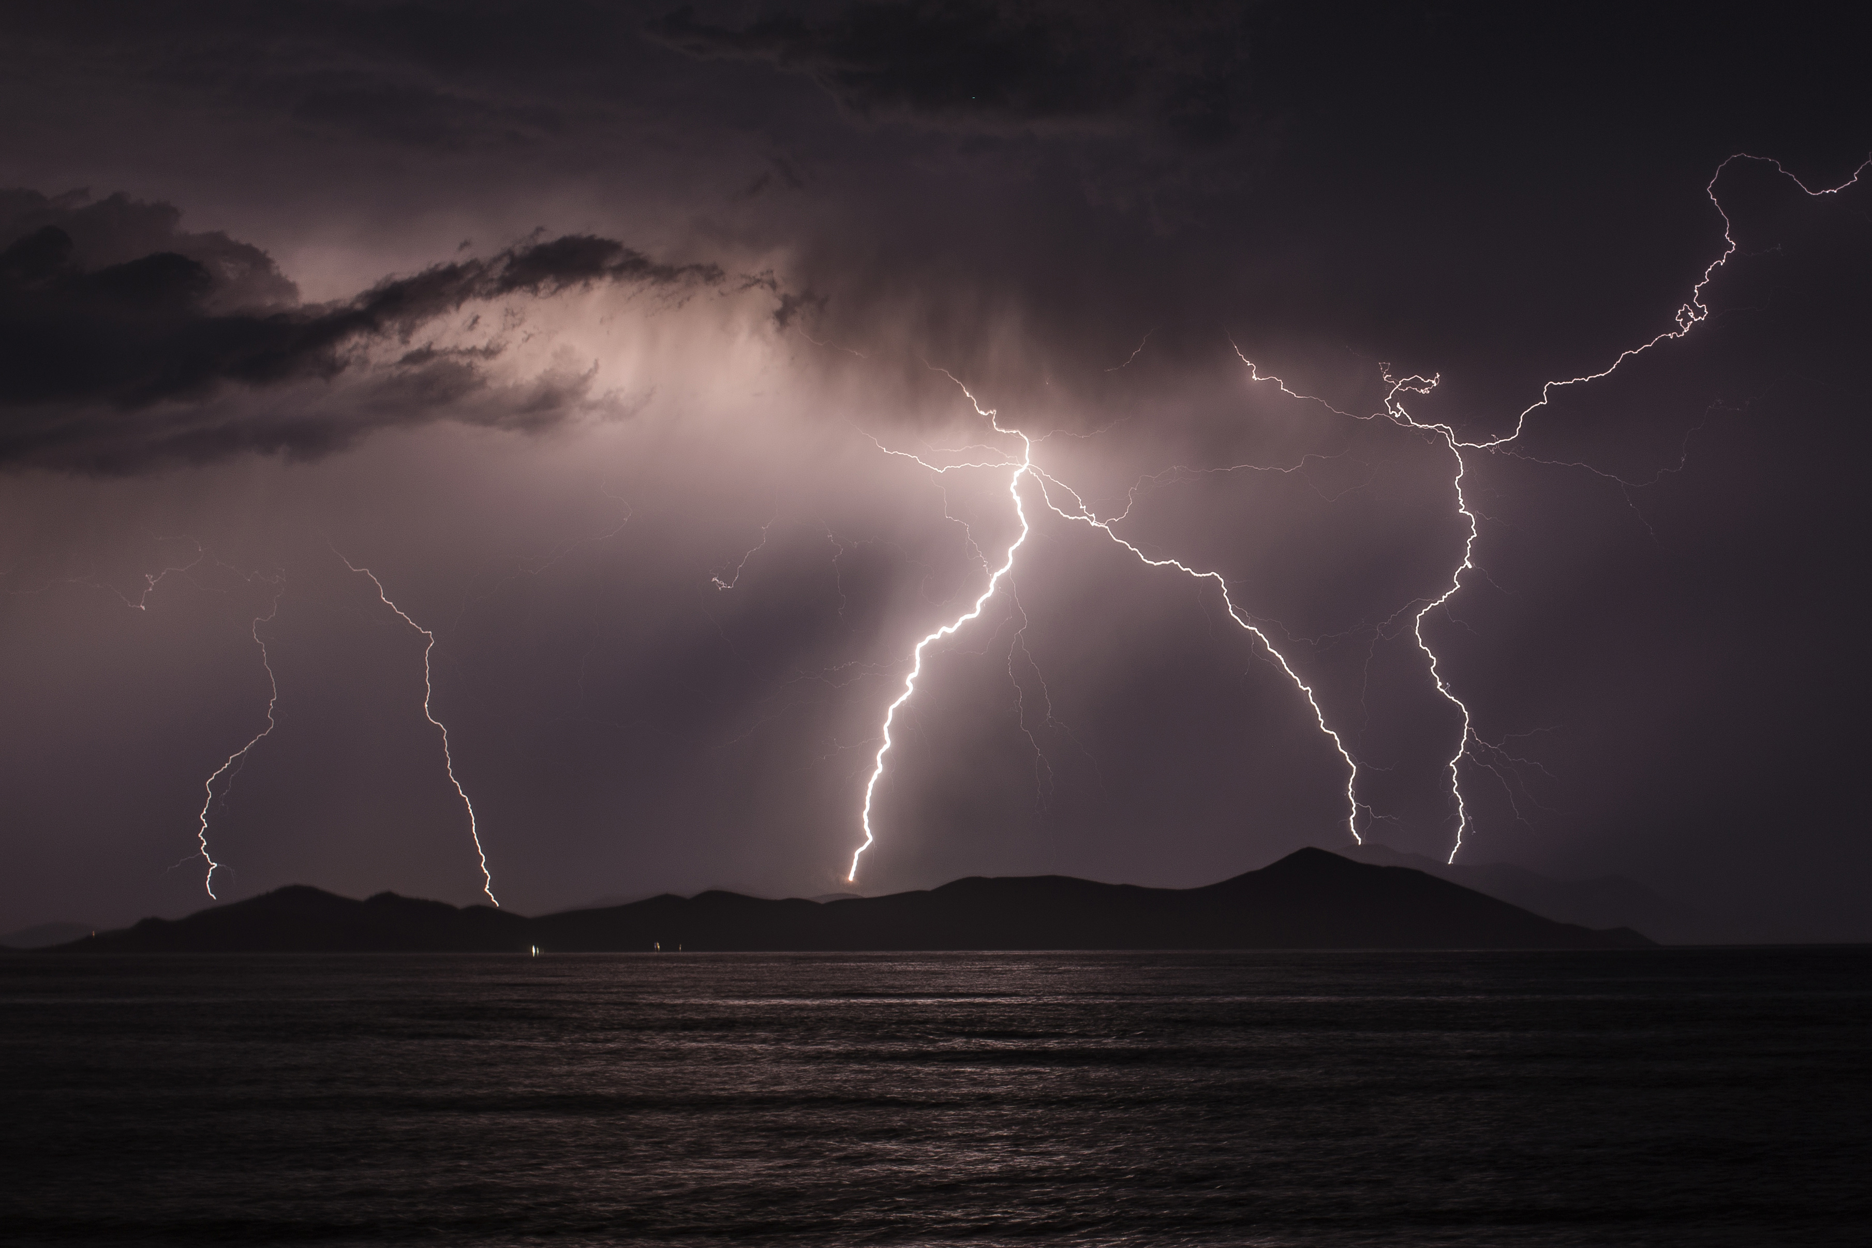
2 Tim 3:1-9
¹But know this, that in the last days perilous times will come: ² For men will be lovers of themselves, lovers of money, boasters, proud, blasphemers, disobedient to parents, unthankful, unholy, ³ unloving, unforgiving, slanderers, without self-control, brutal, despisers of good, ⁴ traitors, headstrong, haughty, lovers of pleasure rather than lovers of God, ⁵ having a form of godliness but denying its power. And from such people turn away!

Slide 4
2 Tim 3:1-9
⁶ For of this sort are those who creep into households and make captives of gullible women loaded down with sins, led away by various lusts, ⁷ always learning and never able
to come to the knowledge of the truth.
⁸ Now as Jannes and Jambres resisted Moses, so do these also resist the truth: men of corrupt minds, disapproved concerning the faith; ⁹ but they will progress no further, for their folly will be manifest to all, as theirs also was.

Slide 5
Perilous times
Strong’s G5467; chalepos:
1) hard to do, to take, to approach
2) hard to bear, troublesome, dangerous
3) harsh, fierce, savage.
Time of stress

Slide 6
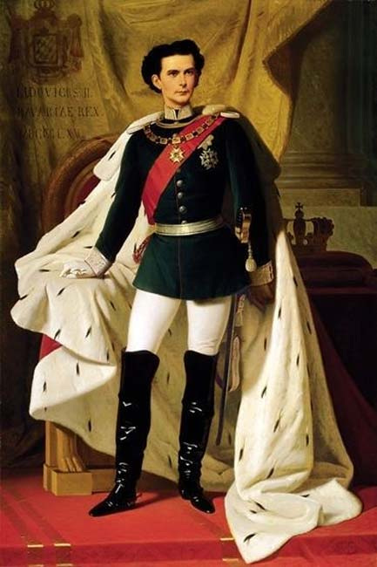
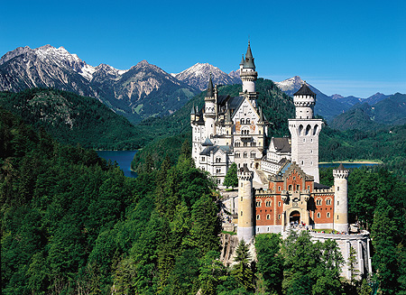

Slide 7
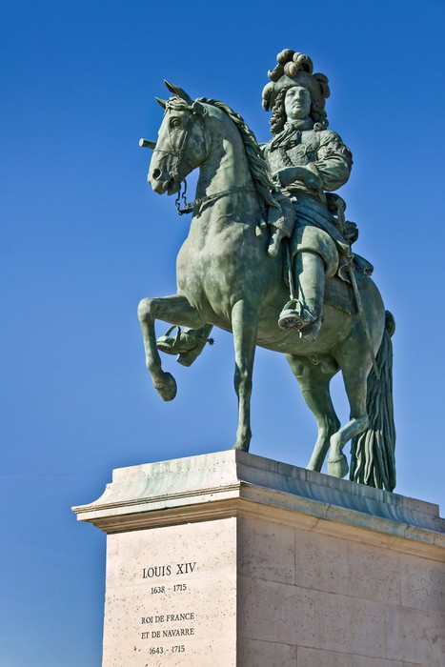
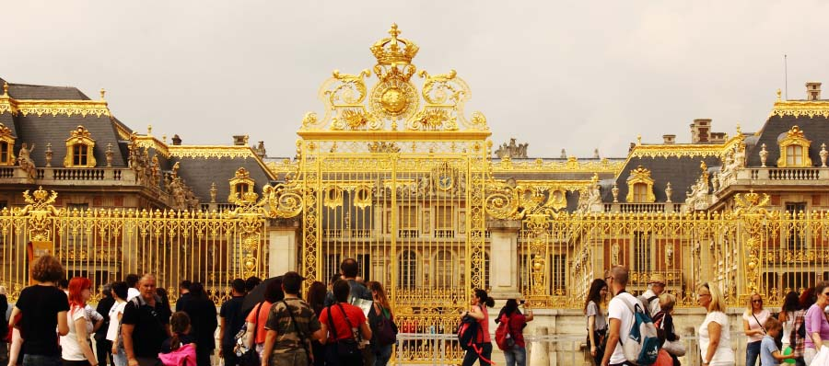
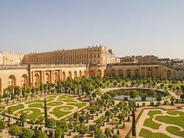

Slide 8
Matt 8:28 (Perilous “people”)
²⁸ When He had come to the other side, to the country of the Gergesenes, there met Him two demon-possessed men, coming out of the tombs, exceedingly fierce, so that no one could pass that way. ²⁹ And suddenly they cried out, saying, “What have we to do with You, Jesus, You Son of God? Have You come here to torment us before the time?”

Slide 9

In times of testing…
1 The 1:3
Work of Faith
Labor of Love
Patience of Hope

Slide 10
FAITH
t
HOLINESS
PEACE
LOVE
HOPE
RIGHTEOUSNESS

Slide 11

A) Work of faith
2 Tim 1:13-14
¹³ Hold fast the pattern of sound words which you have heard from me, in faith and love which are in Christ Jesus. ¹⁴ That good thing which was committed to you, keep by the Holy Spirit who dwells in us.
Jude 1- ²⁰But you, beloved, building yourselves up on your most holy faith, praying in the Holy Spirit, ²¹keep yourselves in the love of God, looking for the mercy of our Lord Jesus Christ unto eternal life.

Slide 12
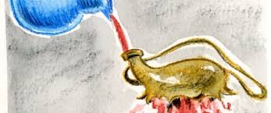
1 Tim 4:13-16
Give attention to
- reading,
- exhortation,
- doctrine.
- Do not neglect THE GIFT
In doing this you will save both yourself and those who hear you.
2 Tim 1:⁶ Therefore I remind you to stir up the gift of God which is in you through the laying on of my hands. ⁷ For God has not given us a spirit of fear, but of power and of love and of a sound mind.

Slide 13
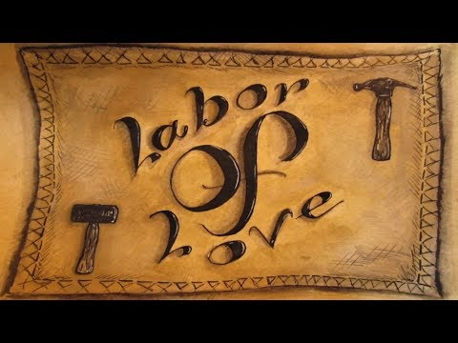

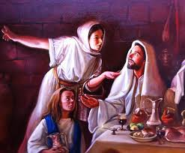
B) Labour of love
1 Tim 1:5
Love from a pure heart
Love from a good conscience
Love from sincere faith

Slide 14
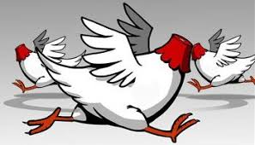
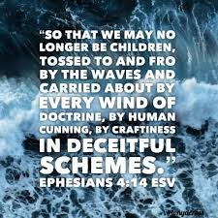
C) Patience of Hope
2 Tim 2 & 2 Tim 4:1-5
¹ You therefore, my son, be
strong in the grace that is in
Christ Jesus. ² And the things that you have heard from me among many witnesses,
commit these to faithful men who will be able to teach
others also. ³ You therefore
must endure hardship as a
good soldier of Jesus Christ.

Slide 15
2 Tim 2:11-13
¹¹ This is a faithful saying:
For if we died with Him,
We shall also live with Him.
¹² If we endure,
We shall also reign with Him.
If we deny Him,
He also will deny us.
¹³ If we are faithless,
He remains faithful;
He cannot deny Himself.

Slide 16
Conclusion
In the last days, there will be perilous times (times of testing).
Our foundation → Faith, Love & Hope
Gal 5:22-23 - But the fruit of the Spirit is love, joy, peace, longsuffering, kindness, goodness, faithfulness, gentleness, self-control.
We have a great God who has prepared a great destiny for us!

